Slide 1
Data Communication networking
Book Referred for this PPT
Stallings W., Data & Computer Communications (9e), Pearson Education Inc., Noida, 2017. Chapter 1.

Slide 2
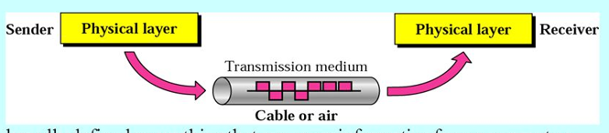
Transmission Medium
Medium used to transmit data. Ex. Cable, air etc.

Slide 3
Networking
Growth of number & power of computers is driving need for interconnection
Rapid integration of voice, data, image & video technologies
Two broad categories of communications networks:
Local Area Network (LAN)
Wide Area Network (WAN)
Notes:
The number of computers in use worldwide is in the hundreds of millions, with pressure from users of these systems for ways to communicate among all these machines being irresistible. Advances in technology have led to greatly increased capacity and the concept of integration, allowing equipment and networks to deal simultaneously with voice, data, image, and even video.
Have two broad categories of networks: Local Area Networks (LAN) and Wide Area Networks (WAN).

Slide 4
Wide Area Networks
Span a large geographical area
Cross public rights of way
Rely in part on common carrier circuits
Technologies used include:
circuit switching
packet switching
frame relay
Asynchronous Transfer
Mode (ATM)
A common carrier, in telecommunications, is an entity that provides wired and wireless communication services to the general public for a fee. A common carrier can be contrasted with a contract carrier, also called a private carrier,
Notes:
Wide area networks generally cover a large geographical area, require the crossing of public right-of-ways, and rely at least in part on circuits provided by a common carrier. Typically, a WAN consists of a number of interconnected switching nodes. Traditionally, WANs have been implemented using one of two technologies: circuit switching and packet switching. More recently, frame relay and ATM networks have assumed major roles.

Slide 5
Circuit Switching
Circuit switching is a connection-oriented network switching technique.
Here, a dedicated route is established between the source and the destination and the entire message is transferred through it.
Uses a dedicated communications path established for duration of conversation
Comprising a sequence of physical links with a dedicated logical channel
eg. telephone network
Notes:
In a circuit-switching network, a dedicated communications path is established between two stations through the nodes of the network. That path is a connected sequence of physical links between nodes, with a logical channel dedicated to the connection. Data generated by the source station are transmitted along the dedicated path as rapidly as possible. The most common example of circuit switching is the telephone network.

Slide 6
Packet Switching
No dedicated transmission capacity along a path through the network.
Rather, data is sent in a sequence of small chunks, called packets.
Each packet is passed through the network from node to node along some path leading from source to destination.
At each node, the entire packet is received, stored briefly, and then transmitted to the next node.
Packet-switching networks are commonly used for terminal-to-computer and computer-to-computer communications.
Notes:
A packet-switching network uses a quite different approach, without need to dedicate transmission capacity along a path through the network. Rather, data is sent in a sequence of small chunks, called packets. Each packet is passed through the network from node to node along some path leading from source to destination. At each node, the entire packet is received, stored briefly, and then transmitted to the next node. Packet-switching networks are commonly used for terminal-to-computer and computer-to-computer communications.

Slide 7
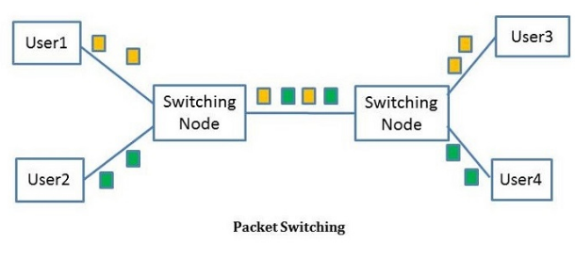

Slide 8
Frame Relay
Packet switching systems have large overheads to compensate for errors
Modern systems are more reliable
Errors can be caught in end system
Frame Relay provides higher speeds with most error control overhead removed :)
Notes:
Frame relay was developed to take advantage of high data rates and low error rates on modern WAN links. Whereas the original packet-switching networks were designed with a data rate to the end user of about 64 kbps, frame relay networks are designed to operate efficiently at user data rates of up to 2 Mbps. The key to achieving these high data rates is to strip out most of the overhead involved with error control.

Slide 9
Asynchronous Transfer Mode
Asynchronous transfer mode (ATM), is a result of developments in circuit switching and packet switching.
ATM can be viewed as an evolution from frame relay.
ATM uses fixed-length packets, called cells.
As with frame relay, ATM provides little overhead for error control.
By using a fixed packet length, the processing overhead is reduced even further for ATM compared to frame relay.
Notes:
Asynchronous transfer mode (ATM), is a culmination of developments in circuit switching and packet switching. ATM can be viewed as an evolution from frame relay. ATM uses fixed-length packets, called cells. As with frame relay, ATM provides little overhead for error control, depending on the inherent reliability of the transmission system and on higher layers of logic in the end systems to catch and correct errors. By using a fixed packet length, the processing overhead is reduced even further for ATM compared to frame relay. The result is that ATM is designed to work in the range of 10s and 100s of Mbps, and in the Gbps range.

Slide 10
Local Area Networks
Smaller scope
Building or small campus
Usually owned by same organization as attached devices
Data rates much higher
Variants:-
Switched LANs, eg Ethernet
Wireless LANs
Notes:
A LAN is a communications network that interconnects a variety of devices and provides a means for information exchange among those devices. The scope of the LAN is small, typically a single building or a cluster of buildings. It is usually the case that the LAN is owned by the same organization that owns the attached devices. The internal data rates of LANs are typically much greater than those of WANs.
LANs come in a number of different configurations. The most common are switched LANs and wireless LANs. The most common switched LAN is a switched Ethernet LAN, others are ATM & Fibre Channel LANs. Wireless networks provide advantages in the areas of mobility and ease of installation and configuration.

Slide 11
Metropolitan Area Networks
MAN
Middle ground between LAN and WAN
Private or public network
High speed
Large area
Notes:
Metropolitan Area Networks provide a middle ground between LANs and WANs, typically spanning a city / metro area with higher speed connections.

Slide 12
The Internet
Internet evolved from ARPANET
first operational packet network
applied to tactical radio & satellite nets also
had a need for interoperability
led to standardized TCP/IP protocols
Notes:
The Internet evolved from the ARPANET, developed in 1969 by the Advanced Research Projects Agency (ARPA) of the U.S. Department of Defense. It was the first operational packet-switching network. The network was so successful that ARPA applied the same packet-switching technology to tactical radio communication (packet radio) and to satellite communication (SATNET). The need for interworking between these led to Vint Cerf and Bob Kahn of ARPA developing methods and protocols for such internetworking, which led eventually to the development of TCP/IP.

Slide 13
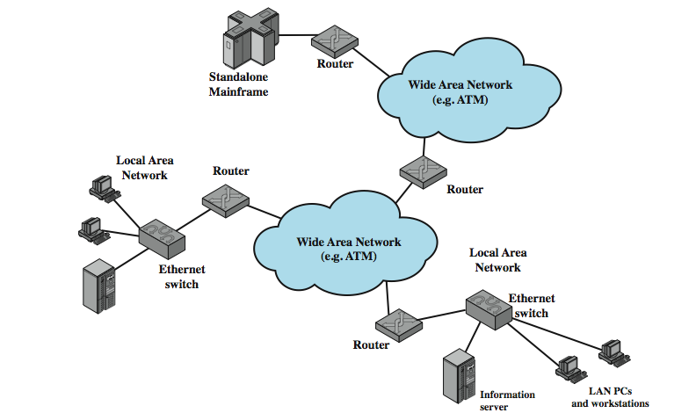
Internet Elements
the key elements that comprise the Internet: [whose purpose is to interconnect end systems] called hosts;
Hosts example:PCs, workstations, servers, mainframes
Most hosts that use the Internet are connected to a network, such as a LAN or a WAN.
These networks are in turn connected by routers.
Notes:
the key elements that comprise the Internet, whose purpose is to interconnect end systems, called hosts; including PCs, workstations, servers, mainframes, and so on. Most hosts that use the Internet are connected to a network, such as a local area network (LAN) or a wide area network (WAN). These networks are in turn connected by routers.

Slide 14
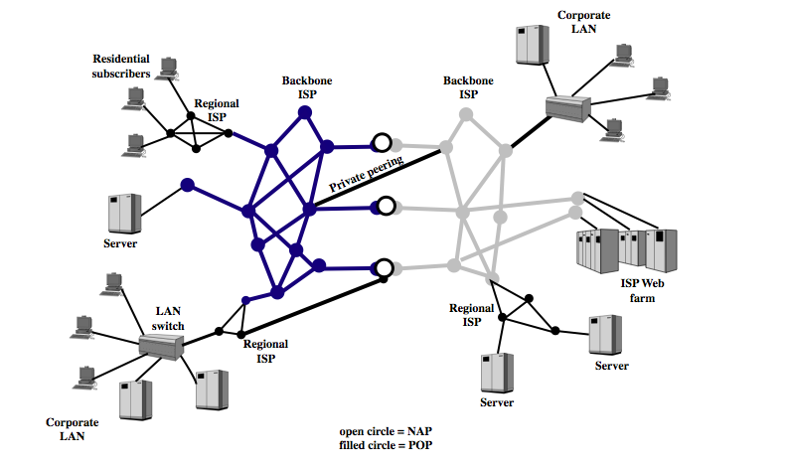
Internet Architecture
The Internet today is made up of thousands of overlapping hierarchical networks,
See hosts grouped into LANs, linked to an ISP through a POP.
The connection is made in a series of steps starting with the CPE.
ISPs can be classified as regional or backbone, with peering links between.
ISP: Internet Service Provider
POP: Point of Presence
CPE: Customer Premises Equipment
Notes:
The Internet today is made up of thousands of overlapping hierarchical networks, an overview of the common, general characteristics can be made.. See hosts grouped into LANs, linked to an an Internet service provider (ISP) through a point of presence (POP). The connection is made in a series of steps starting with the customer premises equipment (CPE). ISPs can be classified as regional or backbone, with peering links between.

Slide 15
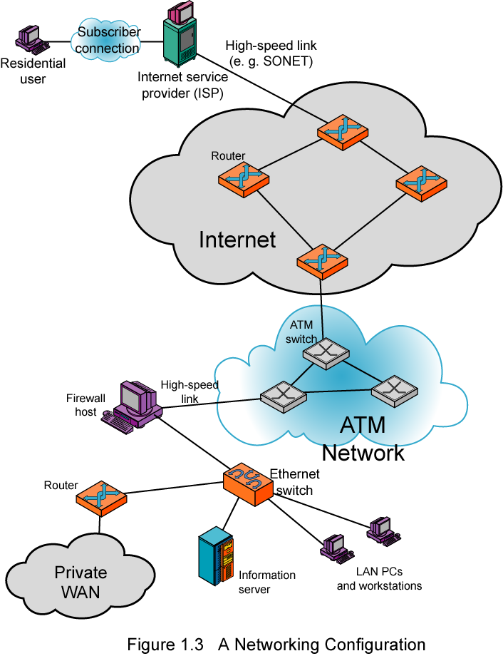
Example Configuration
an individual residential user connected to an ISP through some sort of subscriber connection.
The routers forward packets of data from source to destination through the Internet.
The lower portion shows a LAN implemented using a single Ethernet switch.
This is a common configuration at a small business or other small organization.
Notes:
In the upper-left-hand portion of the figure, we see an individual residential user connected to an Internet service provider (ISP) through some sort of subscriber connection. The Internet consists of a number of interconnected routers that span the globe. The routers forward packets of data from source to destination through the Internet. The lower portion shows a LAN implemented using a single Ethernet switch. This is a common configuration at a small business or other small organization.

Slide 16
Book Referred for this PPT
Stallings W., Data & Computer Communications (9e), Pearson Education Inc., Noida, 2017. Chapter 1.

